Slide 1
Insights from clients reviews
Data Analysis for clients reviews

Slide 2
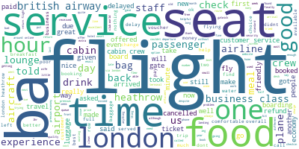
Frequent terms:
As per the shown picture ,the words ‘service’ , ’seat’, ’flight’ , ’food’ , ‘London’ , ‘time’ , ‘food’ are the most frequent detected words in the customers reviews. However, by measuring the average polarity of the collective reviews ,it tends to be positive,which means that the mentioned words are more likely to be mentioned in positive opinions and gives an idea of the areas of positivity.

Slide 3
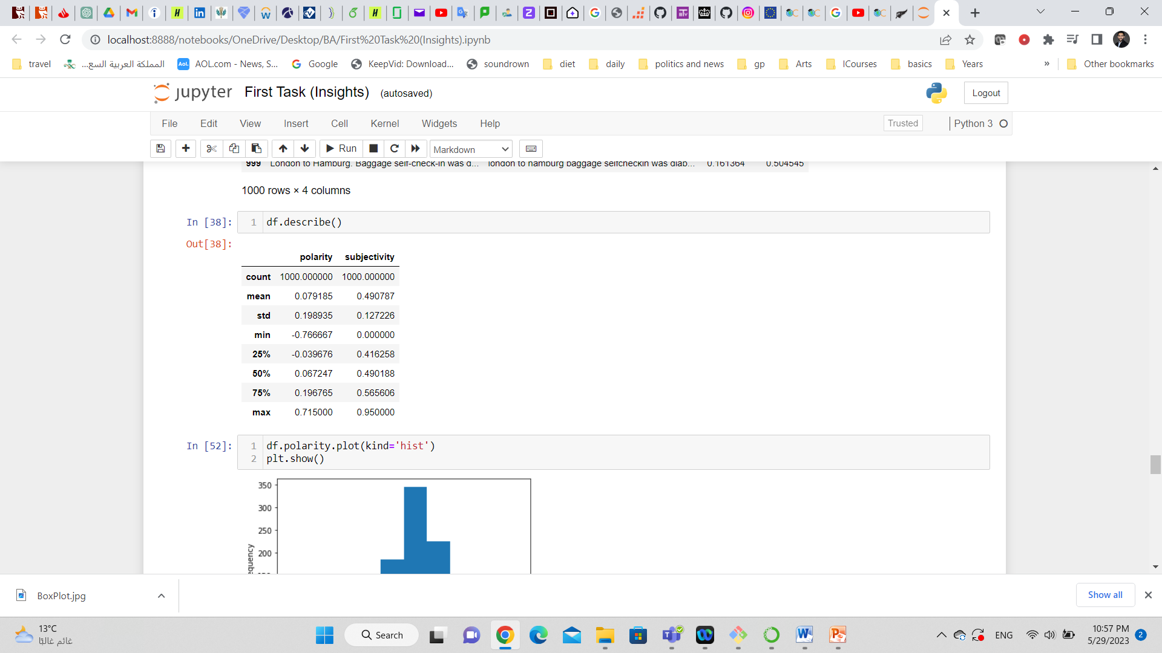
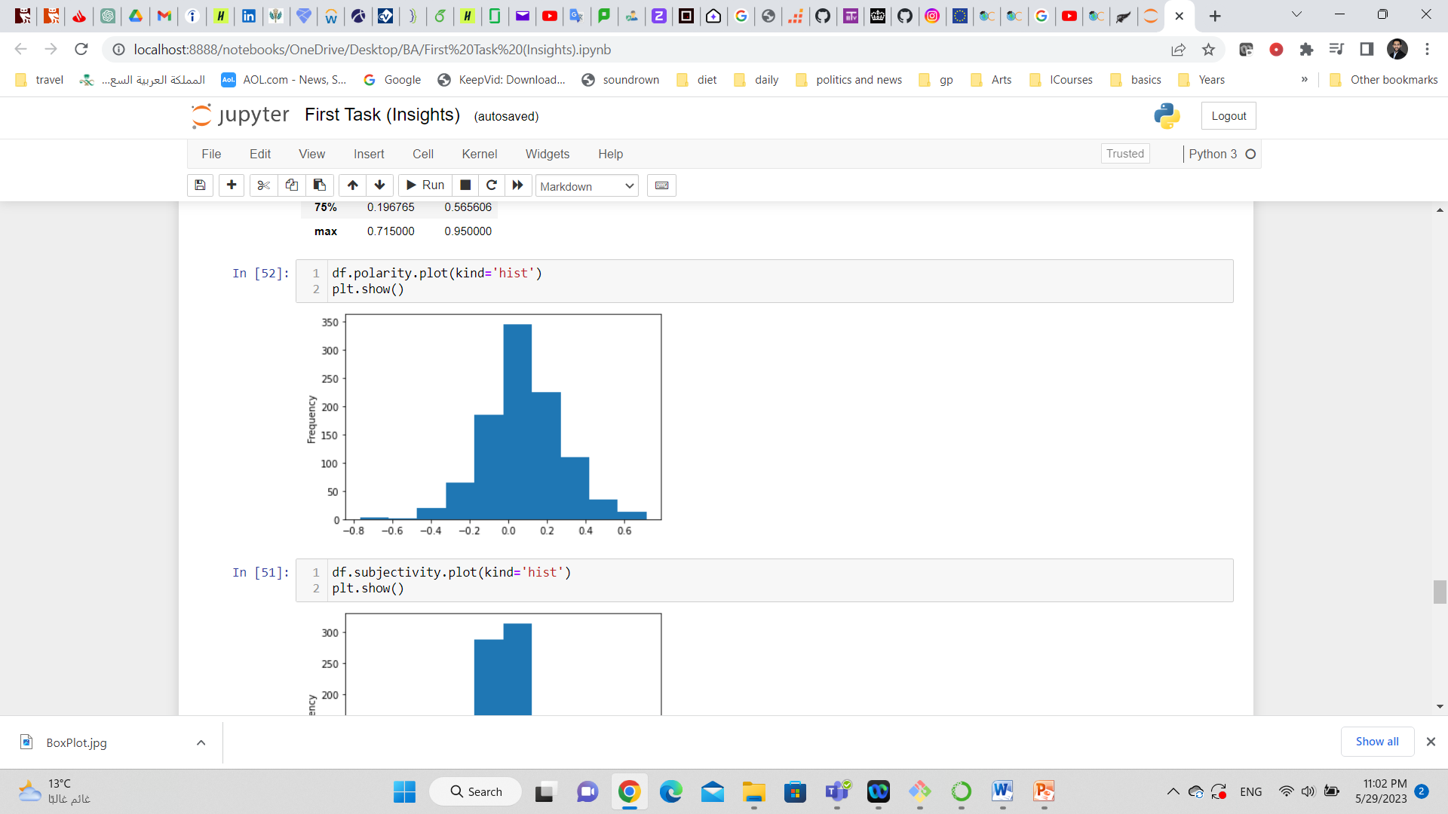
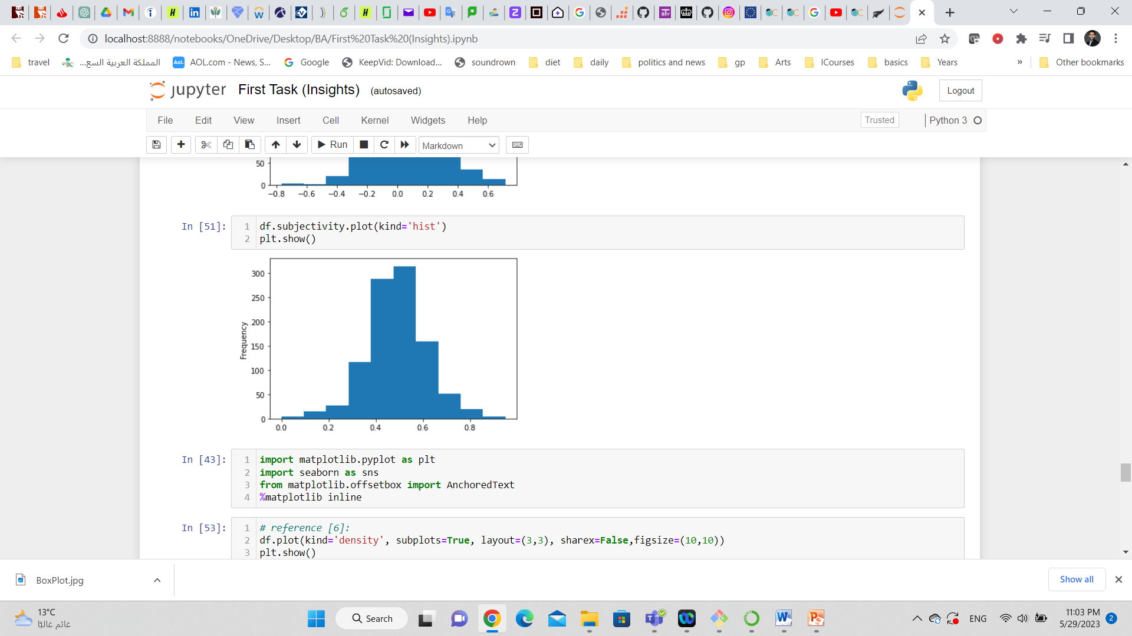
Frequent terms:
From the right table ,the average of polarity and subjectivity of the overall opinions in the customer reviews.
The subjectivity which indicates how much in the sentence is the personal opinion compared to facts, it seems that the overall subjectivity for the overall opinions is nearly 50% which indicates equal opportunity of inclusion of facts and personal opinion.
On the other hand the polarity tends to be more to positive which indicates more positive opinion overall.

Slide 4
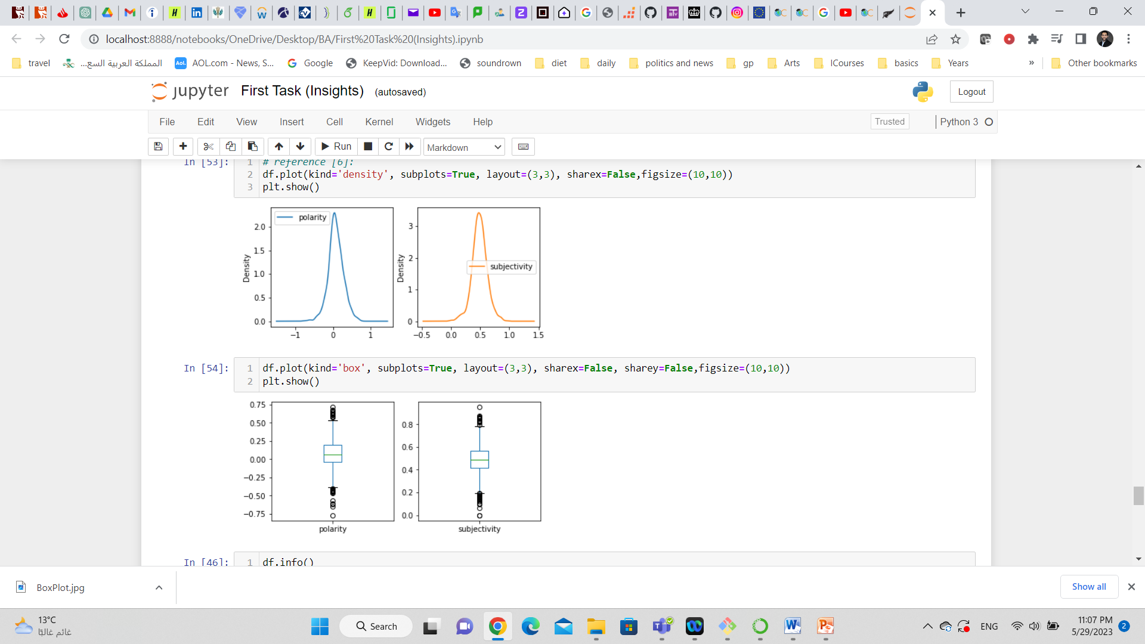
More Plots: ( line and box plots)

